Slide 1

Intro to REST APIs
Presenting: Dr. Aaron Hamachi and Alexander Stevenson
Lab: Adrian Iliesiu
WASTC 2024 virtual Faculty Development Weeks (vFDW)
2B – Set a New Course with DevNet Automation Technologies
Week 2, June 24 – 28

Slide 2
Agenda
API Basics
REST Explained
API Basics
Principles
HTTP Methods
Designing RESTful APIs
Security
Best Practices
Summary
Lab
Q&A

Slide 3


API Basics

Slide 4
API
An API is an Application Programming Interface.
APIs enable two pieces of software to communicate with each other.
To understand any API, start by studying the documentation.
To put together an HTTP request to send to the server, you need to know what the server expects and at which endpoint, including the data formats it wants, and any parameters, optional or required.
Parameters often provide details so that you can scope, filter, or clarify a request. These parameters are usually optional. They can streamline your request or enable you to retrieve information page-by-page.

Slide 5
Base URLs https://developer.cisco.com/docs/service-apis/services-apis-base-urls/ API Features https://developer.cisco.com/docs/service-apis/general-api-features/#general-api-features
Start by Studying the Documentation
Documentation for Cisco Services APIs

Slide 6
Getting Started https://developer.cisco.com/meraki/api-v1/getting-started/#getting-started
Start by Studying the Documentation
Documentation for Meraki Dashboard API
Notes:
6bec40cf957de430a6f1f2baa056b99a4fac9ea0

Slide 7
Getting Started https://developer.cisco.com/docs/nexus-dashboard-fabric-controller/12-2-1/getting-started/#getting-started
Start by Studying the Documentation
Documentation for Nexus Dashboard Fabric Controller API
Notes:
6bec40cf957de430a6f1f2baa056b99a4fac9ea0

Slide 8
Now that we’ve seen what an API is,
let’s take a step back and understand the RESTful architecture which our APIs flow through.
Notes:
6bec40cf957de430a6f1f2baa056b99a4fac9ea0

Slide 9
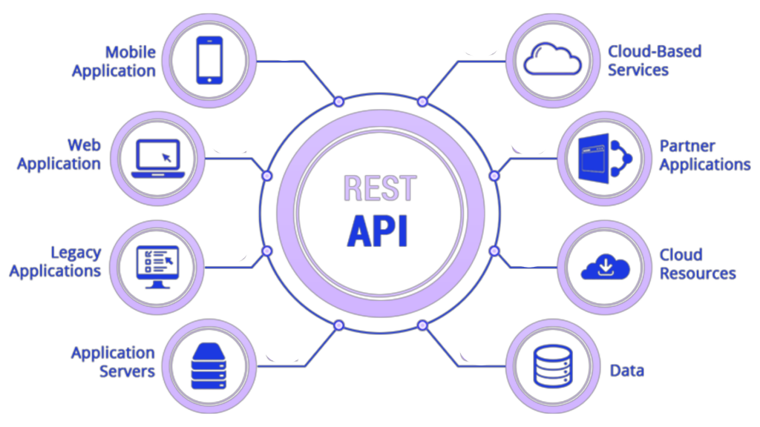
REST Explained

Slide 10
REST
REST stands for REpresentational State Transfer and is just another use for the HTTP Protocol where all requests and responses are sent over TCP/TLS connections using text.
REST is a client-server architecture.
REST is stateless.
REST is cacheable.
REST provides a uniform interface between components.
REST is a layered system.
REST optionally provides code-on-demand.

Slide 11
REST is a client-server architecture…
…which means that the client (such as a user's web browser or mobile application) and the server (which provides the resource or service) operate independently of each other. This separation allows clients and servers to evolve separately, improving scalability and simplifying components on both sides. Clients are not concerned with data storage, which remains internal to each server, and the server is not concerned with the user interface or user state, so that servers can be simpler and more scalable.

Slide 12
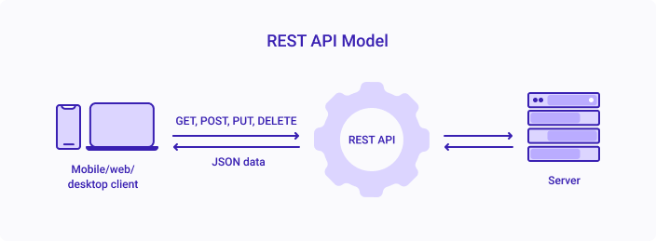
Client-Server Architecture

Slide 13
REST is stateless…
…so each request from a client to a server must contain all the information needed to understand and complete the request. The server does not retain any session information or status about the client between requests. This means that each request is independent and separate, which simplifies server design, improves reliability, and enhances scalability by allowing requests to be serviced by different server processes or even by different servers altogether.

Slide 14
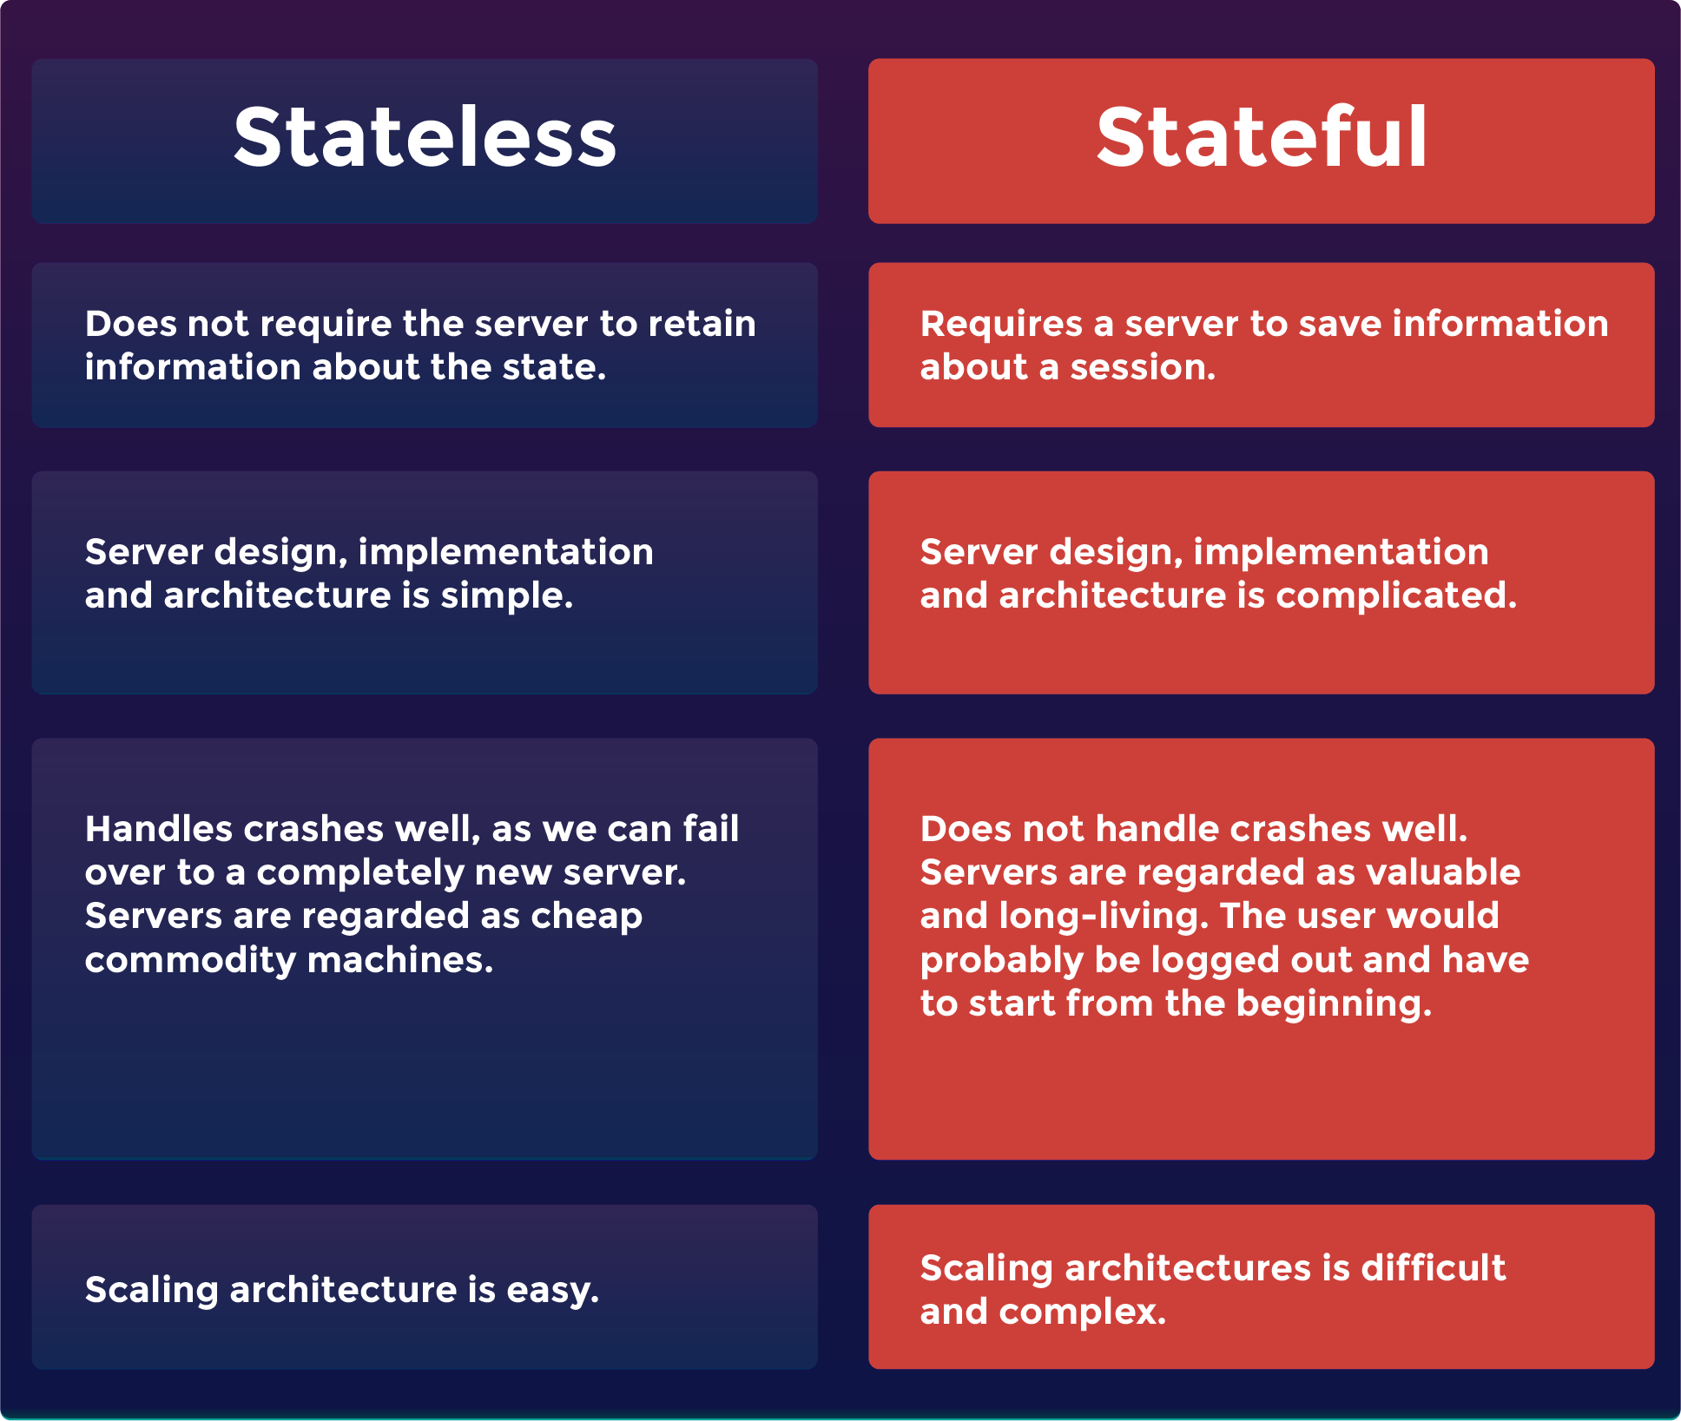
Stateless vs. Stateful

Slide 15
REST is cacheable.
Responses in RESTful systems can be explicitly marked as cacheable or non-cacheable, which means that clients and intermediaries can store cacheable responses to reuse for later, equivalent requests. This cacheability reduces the need for some client-server interactions, decreases server load, and improves overall system efficiency and performance. Properly managed caching partially or completely eliminates some client-server interactions, further enhancing the scalability and performance of the service.

Slide 16
REST provides a uniform interface between components.
The uniform interface between components simplifies and decouples the architecture, which allows each component to evolve independently. A RESTful system operates on resources (any information that can be named) through a consistent and predefined set of operations (such as HTTP GET, POST, PUT, DELETE), and it uses a standard way of communicating resource representations over a network. This uniformity reduces the learning curve for developers, fosters greater understanding of the system, and enhances the ability to diagnose problems.

Slide 17
REST is a layered system.
REST allows the use of a layered system architecture to organize servers into hierarchies of layers. Each layer can only "see" the immediate layer with which it is interacting. This means that a client might be connected to an intermediary server (like a load balancer or a proxy) rather than the end server actually providing the service. Layered systems enhance security (due to the ability to restrict components to certain layers) and allow components to be added, removed, modified, or replaced without affecting the rest of the system.

Slide 18
REST optionally provides code-on-demand.
REST's optional code-on-demand feature allows servers to extend the functionality of a client by transferring executable code, such as Java applets or JavaScript. This can be useful for supporting a part of the application that changes frequently or dynamically, without the need for redeploying the client. It's the least used constraint of REST because it relies on the client being able to execute the code safely and can complicate the client application. However, when used appropriately, it can greatly enhance the flexibility and power of the client-server interaction.

Slide 19
REST Data Formats
When sending a request, data formats are also called payloads. Refer to the REST API Documentation for your product to learn if it supports JSON and XML as data formats.
JSON stands for JavaScript Object Notation. It's a lightweight text-based open standard designed for human-readable data interchange. You can read more about it at http://www.json.org/. Many REST APIs work with JSON.
XML stands for eXtensible Markup Language. It is a language designed to store and transport data.

Slide 20
REST Data Formats
{
"user": {
"id": 123,
"firstName": "John",
"lastName": "Doe",
"email": "john.doe@example.com"
}
}

Slide 21
REST Data Formats
<user>
<id>123</id>
<firstName>John</firstName>
<lastName>Doe</lastName>
<email>john.doe@example.com</email>
</user>

Slide 22
REST Data Formats
When sending a request, data formats are also called payloads. Refer to the REST API Documentation for your product to learn if it supports JSON and/or XML as data formats.
JSON stands for JavaScript Object Notation. It's a lightweight text-based open standard designed for human-readable data interchange. You can read more about it at http://www.json.org/. Many REST APIs work with JSON.
XML stands for eXtensible Markup Language. It is a language designed to store and transport data.

Slide 23
HTTP Methods
For each data format, the data may be contained in the body of the request. POST, PUT, and PATCH requests typically include data requirements or optional parameters as part of the request.
HTTP Verb | Typical Action (CRUD)
POST | Create
GET | Read
PUT | Update
PATCH | Update
DELETE | Delete

Slide 24

HTTP Methods
You might be asking yourself, what’s the difference between a
PUT and a PATCH? They both Update….
HTTP Verb | Typical Action (CRUD)
POST | Create
GET | Read
PUT | Update
PATCH | Update
DELETE | Delete

Slide 25
Section Header

Slide 29
Section Header

Slide 33
Section Header

Slide 36
Section Header

